Slide 1


Communication Principles
Project 1: FM receiver based on the pre-recorded signal
Speaker: 孙逸涵 杨佳怡 张旭东
Date: 2022.04.24

Slide 2

Background
FM receiver receives and demodulates radio signal which is transmitted by FM carrier.
Better performance than AM modulation because of the shorter wavelength used and better noise reduction performance.
The transmission distance is relatively shorter because of the shorter wavelength.

Slide 3

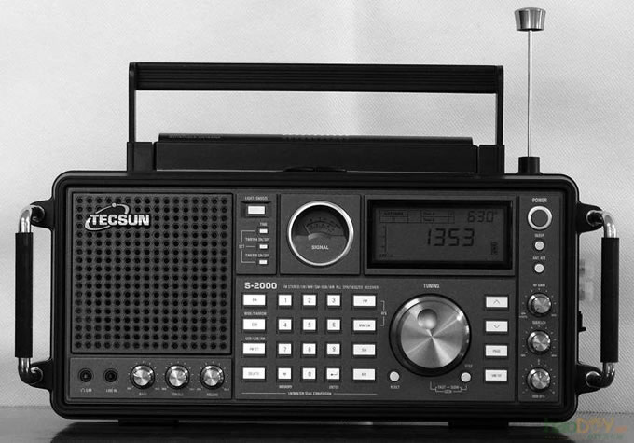
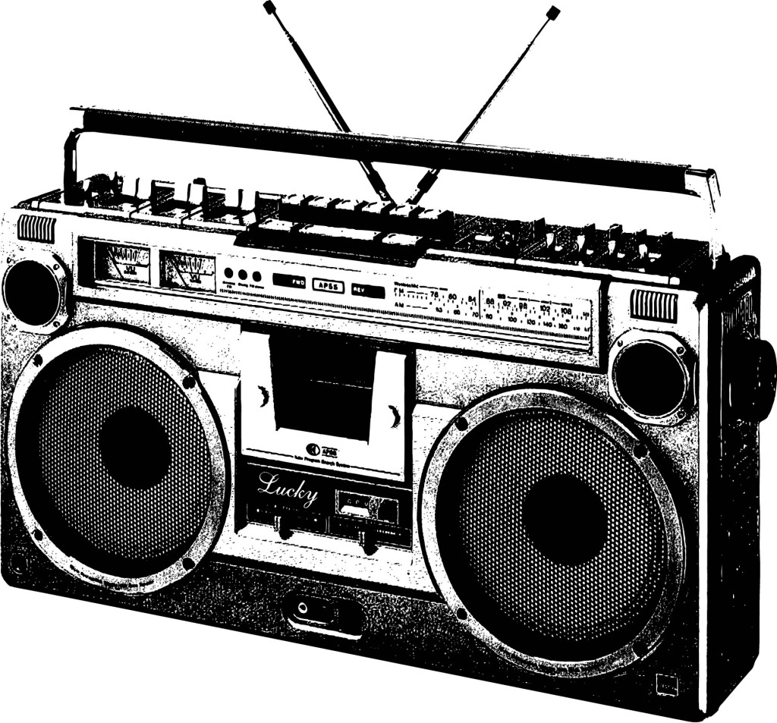
Direct amplification FM receiver
Superheterodyne FM receiver
(Based on circuit program)
Single tone FM receiver
FM stereo radio
(Based on received signal and type)
Difference :
stereo regulator is added after frequency detector of FM
Stereo Radio which separate out two radio channels to push two speakers to create stereo sound.

Slide 4

CATALOGUE
01
Introduction
02
Implementation of FM receiver
Introduction of FM receiver
Implementation of FM Receiver by LabVIEW and by DLL
03
Design of multi-channel system
04
Design of User Interface
Design of FM multi-channel system by LabVIEW
UI of FM receiver

Slide 5

01
Introduction

Slide 6
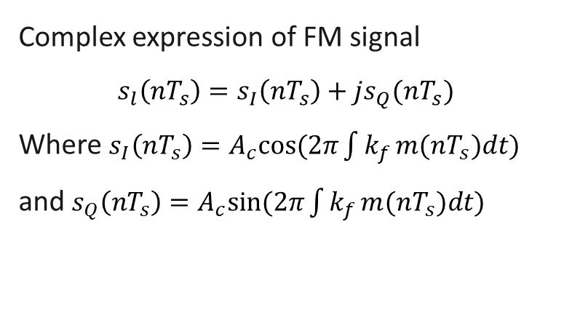

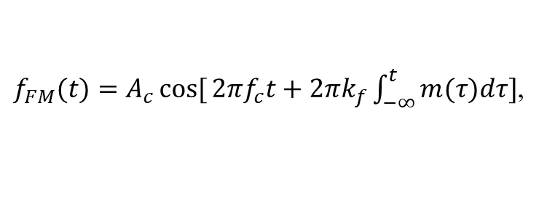
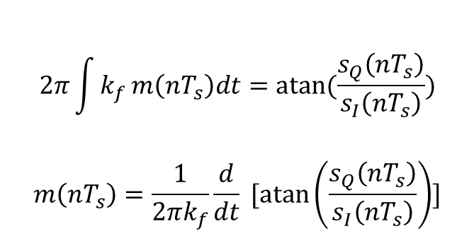
Theoretical Analysis
FM Modulation
Demodulation: Arc tangle method
Instantaneous carrier frequency
$${f(t)}_{i}=fc+k_{f}m(t)$$
$$2π\int{k_{f}}m\left(nT_{s}\right)dt=atan⁡(\frac{s_{Q}\left(nT_{s}\right)}{s_{I}\left(nT_{s}\right)})$$
$$m\left(nT_{s}\right)=\frac{1}{2πk_{f}}\frac{d}{dt} [\operatorname{atan}\left(\frac{s_{Q}\left(nT_{s}\right)}{s_{I}\left(nT_{s}\right)}\right)]$$
$f_{FM}(t)=A_{c}\cos{[}2πf_{c}t+2πk_{f}\int_{−∞}^{t}{m(τ)dτ}]$,
Complex expression of FM signal
$$s_{l}\left(nT_{s}\right)=s_{I}\left(nT_{s}\right)+js_{Q}(nT_{s})$$
Where $s_{I}\left(nT_{s}\right)=A_{c}cos⁡(2π\int{k_{f}}m(nT_{s})dt)$
and $s_{Q}\left(nT_{s}\right)=A_{c}sin⁡(2π\int{k_{f}}m(nT_{s})dt)$

Slide 7
02
Implementation of FM receiver

Slide 8
System model
Pre-recorded data
Wireless
Channel
FM
Demodulator
Play
Waveform
Notes: As being limited by hardware conditions, this FM receiver project was based on the LABVIEW simulation.

Slide 9

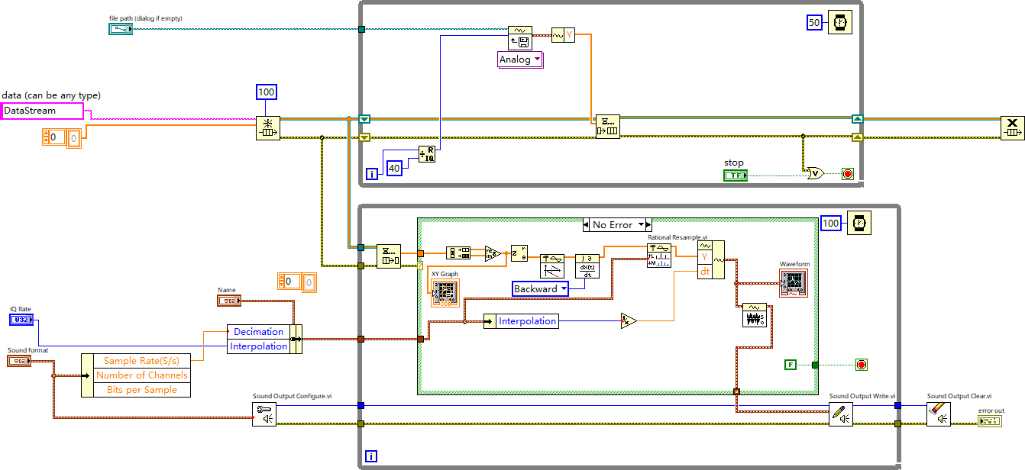
Block Diagram(By LabVIEW)

Slide 10
Producer-Consumer Design Pattern
Producer - Acquisition of signal
Consumer - Signal processing and display

Slide 11
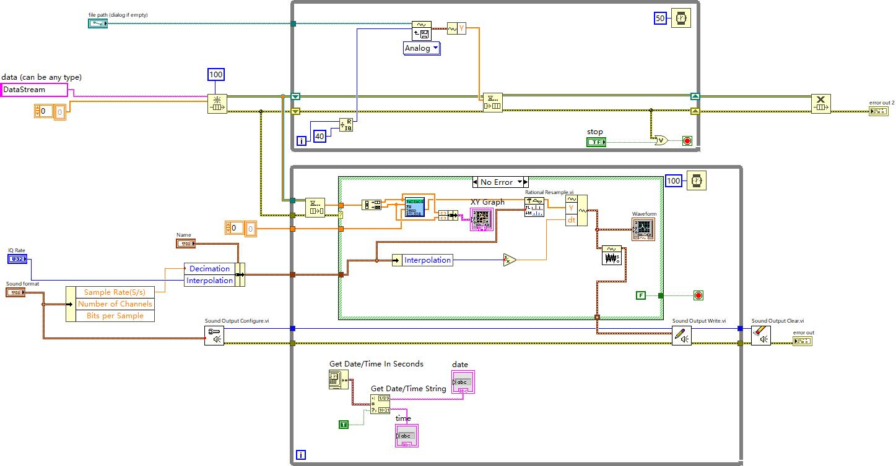
Block Diagram(By DLL)

Slide 12
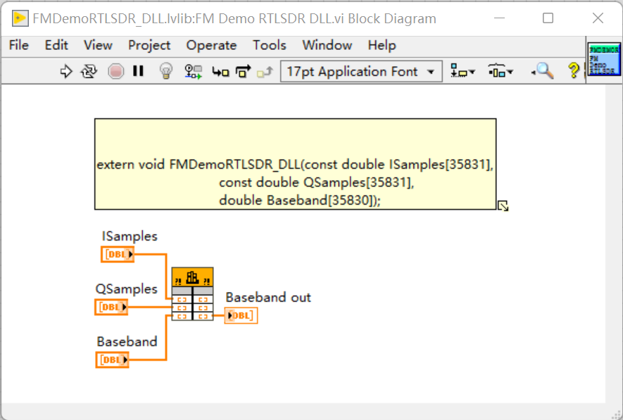
DLL(Dynamic Link Library)
MATLAB implement FM demodulation
Using Coder Tool to generate DLL
Labview import DLL and use Userlibrary subVI to demode
MATLAB CODE
function Baseband=FMDemoRTLSDR_DLL(ISamples,QSamples)
phase=atan2(ISamples,QSamples);
phase_Unwrap=unwrap(phase);
Baseband=diff(phase_Unwrap);
End

Slide 13

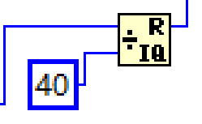
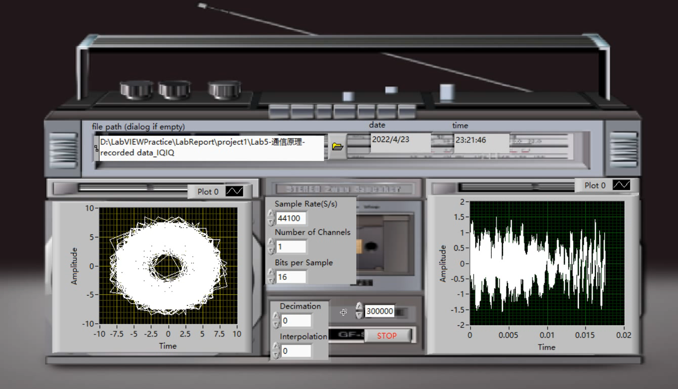
Result
Sound
We find this module can control the length of the music. As the number increases, the length gets longer.
Length of music
Constant=40
Constant=100
Constant=160
Video

Slide 14
The influence of IQ rate
IQrate should among the range of [275000,315000], otherwise the music played is unstable and distortional.
IQ rate=230kHZ
IQ rate=400kHZ
In the FM receiver Project, the frequency range of the voice signal is 0-20kHZ, so it is generally set to 300KHZ to restore the original signal

Slide 15
03
Design of multi-channel system

Slide 16
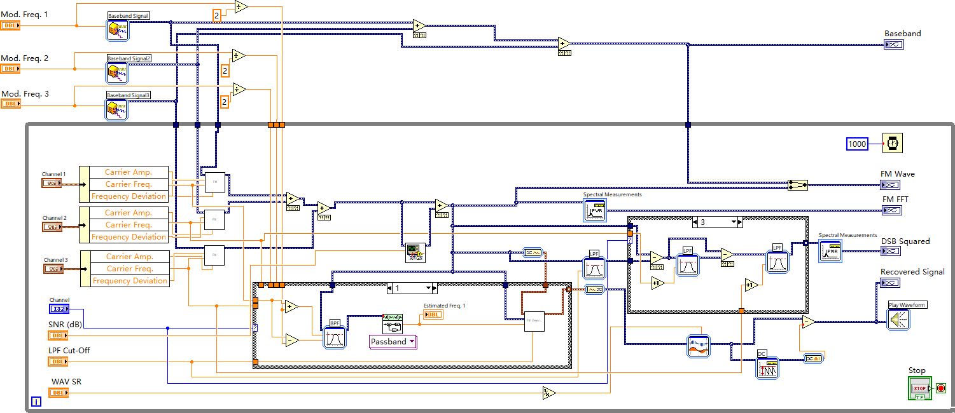
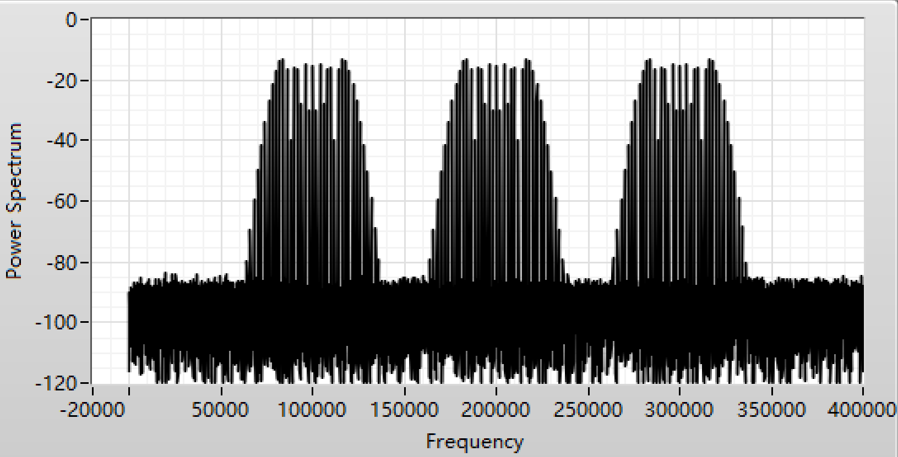
Block Diagram(Single Tone)

Slide 17
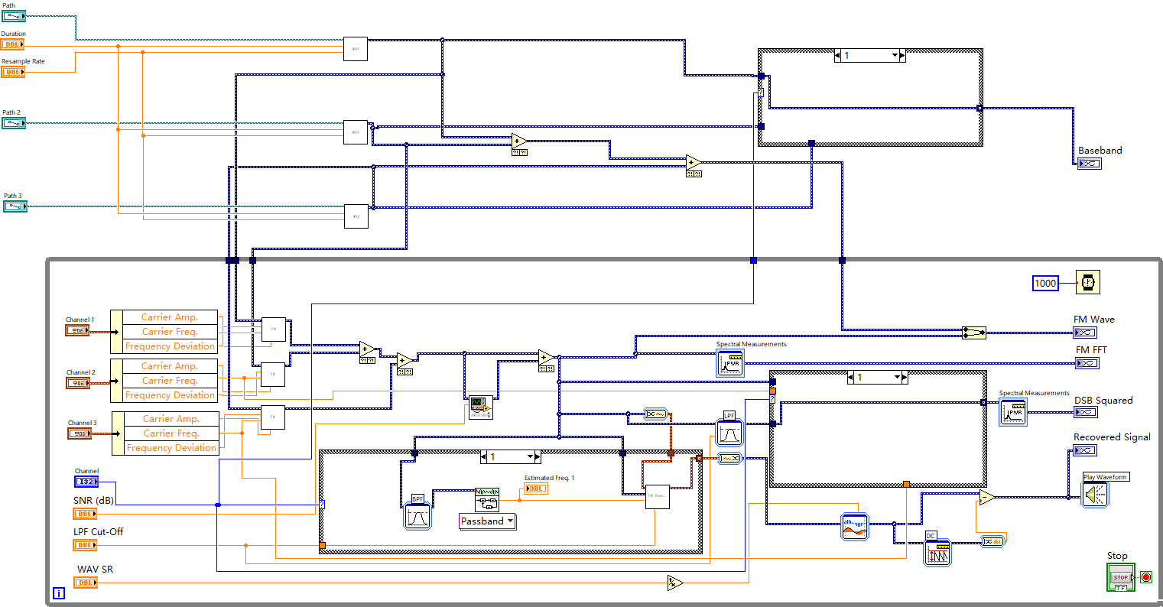
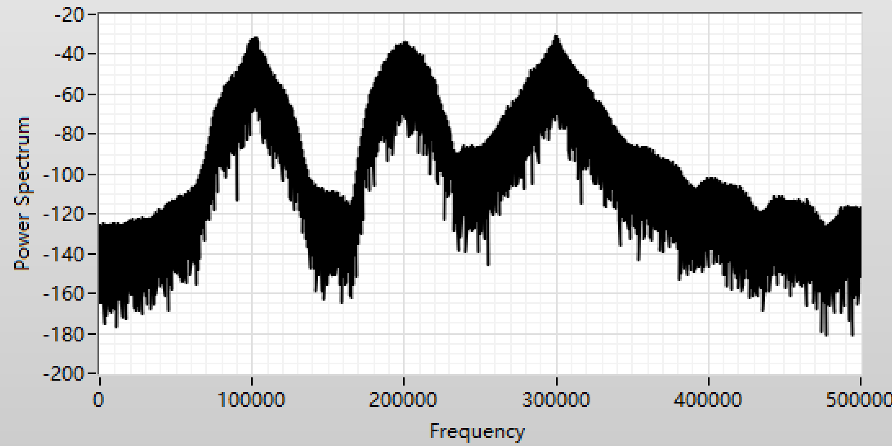
Block Diagram(WAV)

Slide 18

04
Design of User Interface

Slide 19
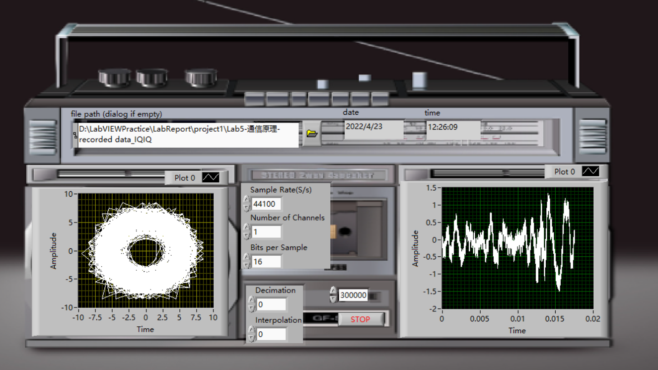
User Interface
This is our design of user interface. We find a picture of FM radio interface which serves as the background. What’s more, time indicator is added to Producer-Consumer Design Pattern so that it can display the time in real time when running.

Slide 20
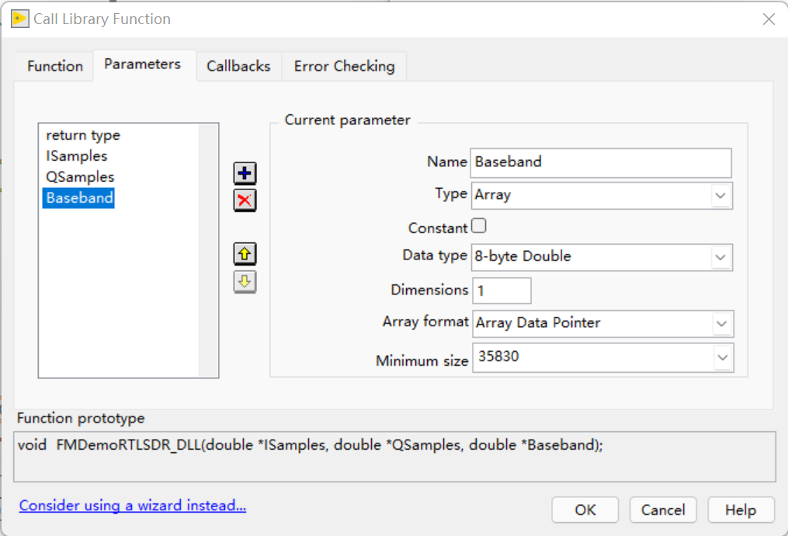
Experience
Meet some problem in DLL implement, the music played card by using default setting of parameters.
Find that only when the setting of channel and sample rate are (1,44100) or (2,22050), this project can run successfully. But we do not figure out why.

Slide 21
Division of labor in group
孙逸涵: FM receiver by Labview, FM multi-channel system, PPT making
杨佳怡: FM receiver by DLL, Performance evaluation, PPT making
张旭东: User Interface, Background, Performance evaluation, PPT making

Slide 22
Thanks ！

